Slide 1
D3 Tutorial
CSE 578

Slide 2
Introduction
D3 stands for Data-driven Documents.
The data is provided by us. The documents are web-based documents(such as HTML or SVG). D3 connects our data to our documents.

Slide 3
D3 functionality
Loading data into the browser’s memory
Binding data to elements within the document, creating new elements as needed
Transforming those elements by interpreting each element’s bound datum and setting its visual properties accordingly
Transitioning elements between states in response to user input
Transformation step is where the mapping between data and its corresponding visual appearance happens.

Slide 4
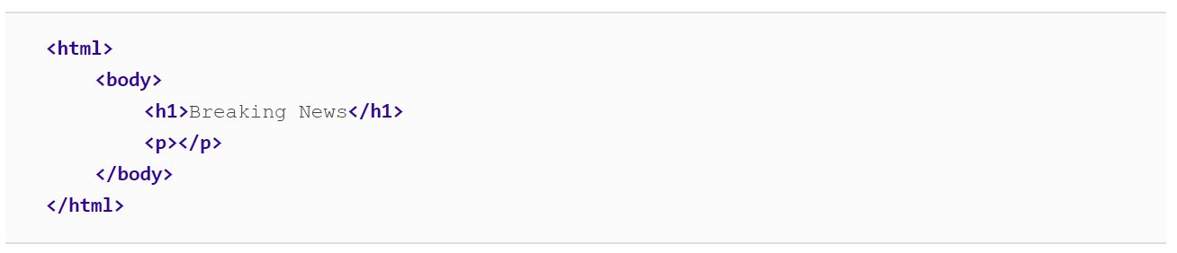
Some basics – DOM
The term Document Object Model refers to the hierarchical structure of HTML. So an HTML document is essentially a tree with <html> tag as the root.
body is the parent element to both of its children, h1 and p (which are siblings to each other). All elements on the page are descendants of html.

Slide 5
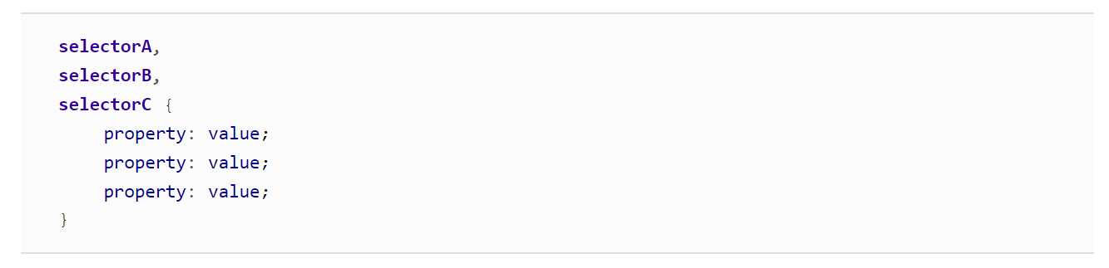
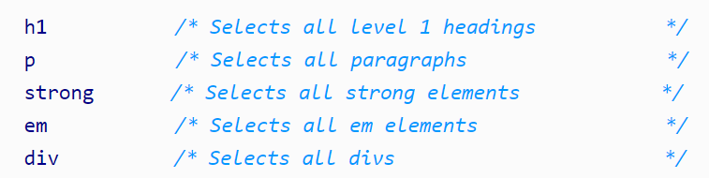

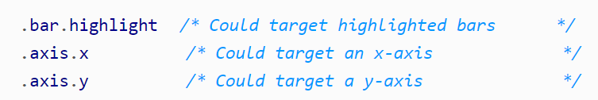
Some basics – CSS selectors
Cascading Style Sheets are used to style the visual presentation of DOM elements

Slide 6


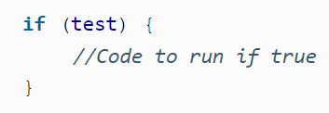
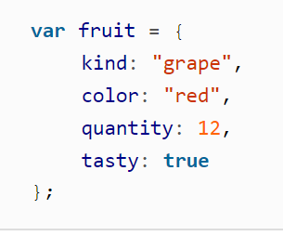
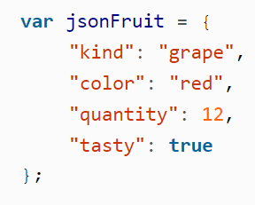
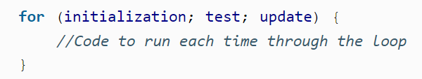
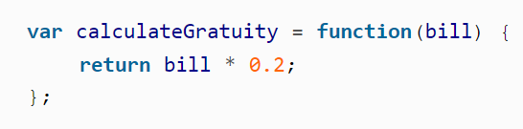
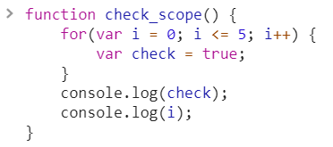

JavaScript
JavaScript is the scripting language that can make pages dynamic by manipulating the DOM after a page has already loaded in the browser.
Variables
Control Structures
Functional-level scope
In JavaScript, variables are scoped at the function level, meaning they are accessible anywhere within the function (not block) in which they reside.
Functions

Slide 7
JavaScript - Console
Console is where you can
see your DOM elements and their CSS properties(even manipulate them)
all the variables in different scopes
Debug your code(set checkpoints in your javascript code, step in your code)
Run JavaScript code

Slide 8
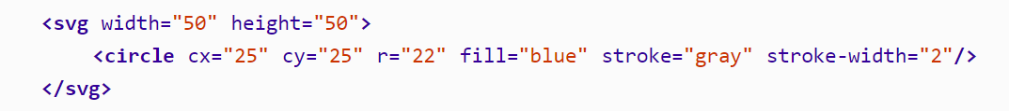
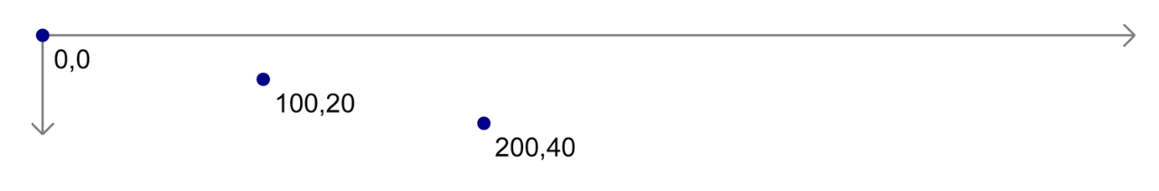
HTML – SVG
Think of the SVG element as a canvas on which your visuals are rendered.
We can include a number of visual elements between svg tags, including rect, circle, ellipse, line, text, and path.

Slide 9
D3
Data
D3
SVG elements

Slide 10
Enter
5
10
15
20
25
<text>
<text>
<text>
<text>
<text>
SVG
Data
enter
Empty Container

Slide 11
Enter, Merge
5
10
15
20
25
6
11
16
21
26
30
6
11
16
21
26
30
SVG
Data
enter
30
merge
Created Container
[6, 11, 16, 21, 26, 30]

Slide 12
Exit
5
10
15
20
25
6
11
16
21
25
SVG
Data
exit
25
Created Container
[6, 11, 16, 21]

Slide 13
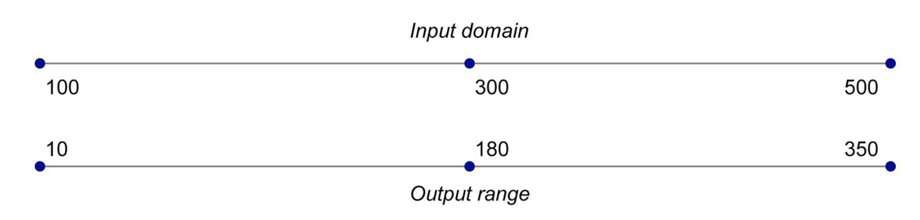
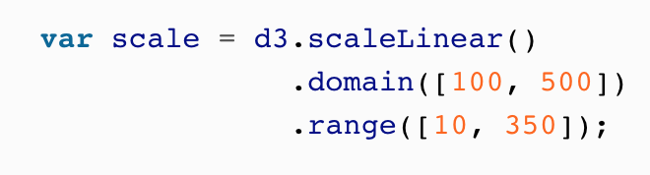
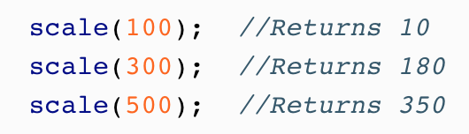
Scales

Slide 14
Keys: enter
1:5
2:10
3:15
4:20
5:25
6
11
21
16
26
30
6
11
16
21
26
30
SVG
Data
enter
30
merge
Created Container
[1:6, 2:11, 4:16, 3:21, 5:26, 6:30]

Slide 15
Keys:exit
1:5
2:10
3:15
4:20
5:25
1:6
2:11
3:21
4:16
5:26
SVG
Data
exit
2:11
Created Container
[1:6, 3:21, 4:16, 5:26]

Slide 16
Layouts
D3 layouts take data that you provide and remap or otherwise transform it, thereby generating new data that is more convenient for a specific visual task.

Slide 17
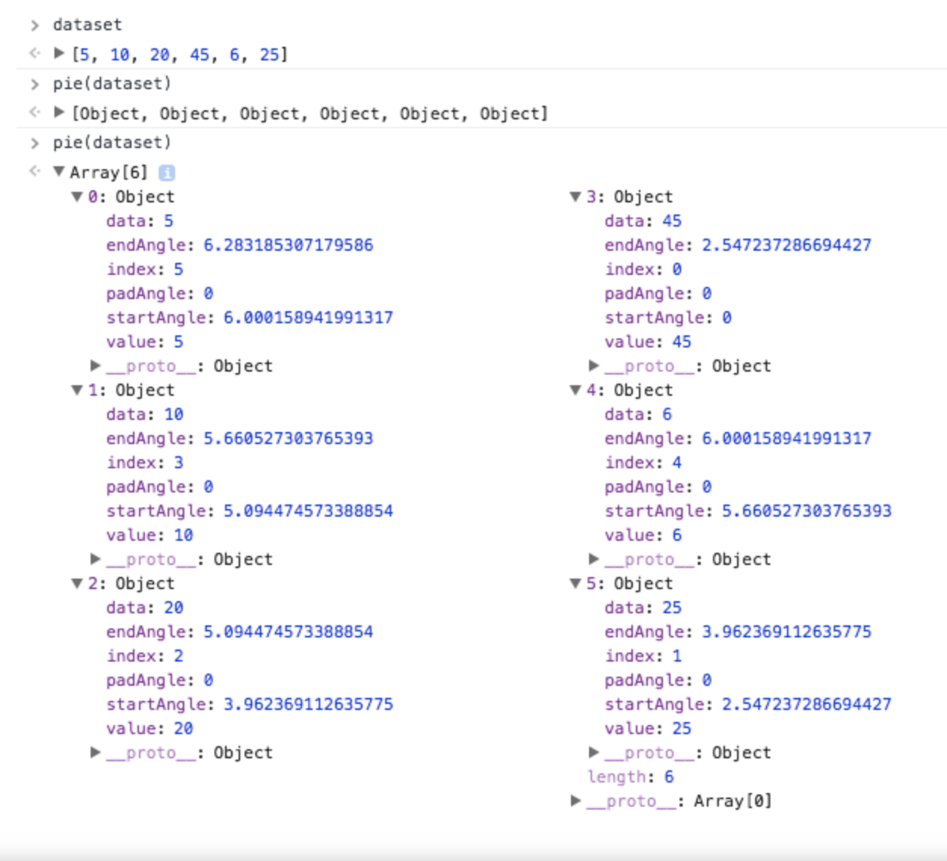
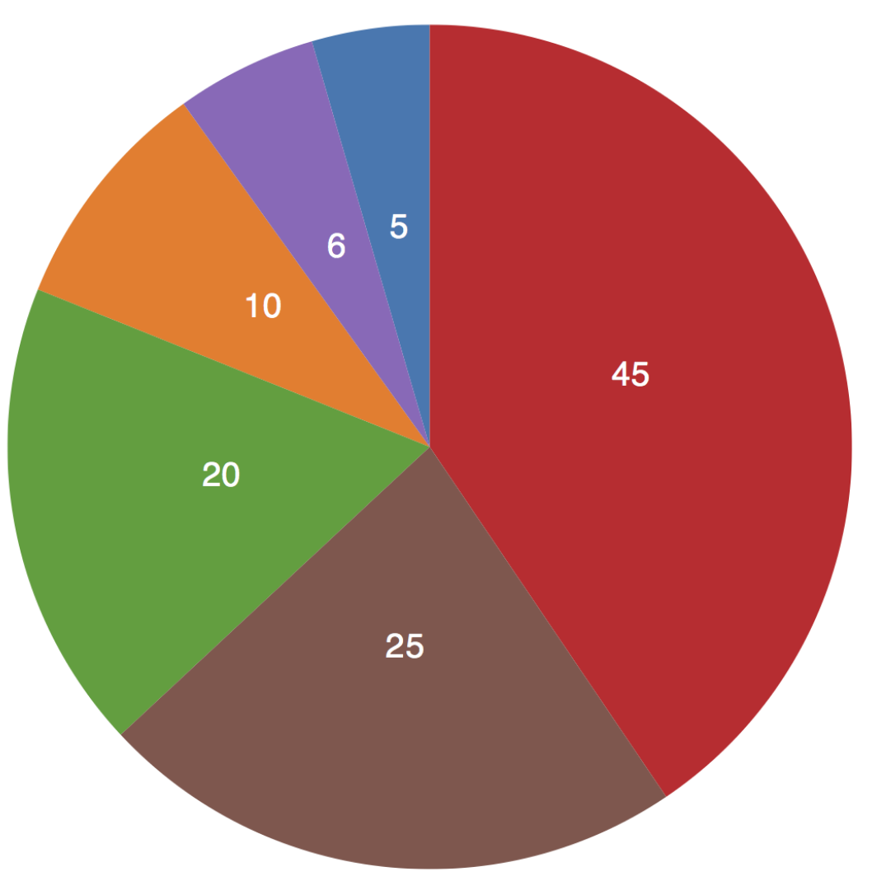
Pie Chart

Slide 18
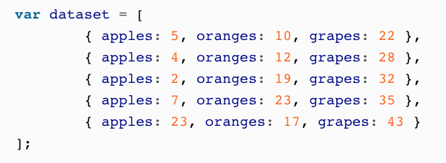
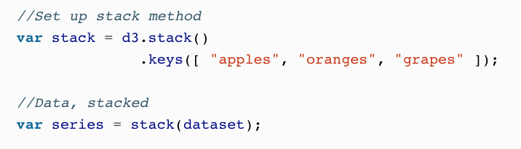
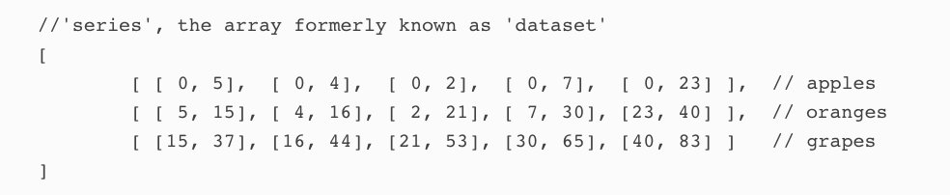
Stacked Area
d3.stack() converts two-dimensional data into “stacked” data; it calculates a baseline value for each datum, so you can “stack” layers of data on top of one another.

